Slide 1
Smart home for the elderly
TEAM 6

Slide 2



PURPOSE
In the age of technology and the increasing use of IoT to interact with the world automatically, building a smart home is one of the best ways to improve your lifestyle, and transform it to one of ease, safety and wellbeing.
In our specialized home for the elderly, we maximizes focus on safety and health, allowing senior citizens to live a comfortable life, while ensuring their safety and comfort.

Slide 3


PROBLEM
safety
Senior citizens living alone can be stressful to all the family members involved, with a high risk of accidents and health crises
COSTS
Alternatives like hiring a private nurse of frequent hospital checkups can be a burden on senior citizens and their families
ALTERNATIVES
Taking care of senior family members often compromise on their privacy and comfort.

Slide 4
SOLUTION
Health
Ensure that senior citizens are safe with constantly updated health data as well as with a safe environment with disaster detection
COST SAVINGS
Reduce expenses as compared to alternatives
EASY TO USE
A simple UI allows one to see current statuses, ambient data, as well as alerts
convenience
Switch lights on and close doors with one tap

Slide 5
HARDWARE OVERVIEW

Slide 6
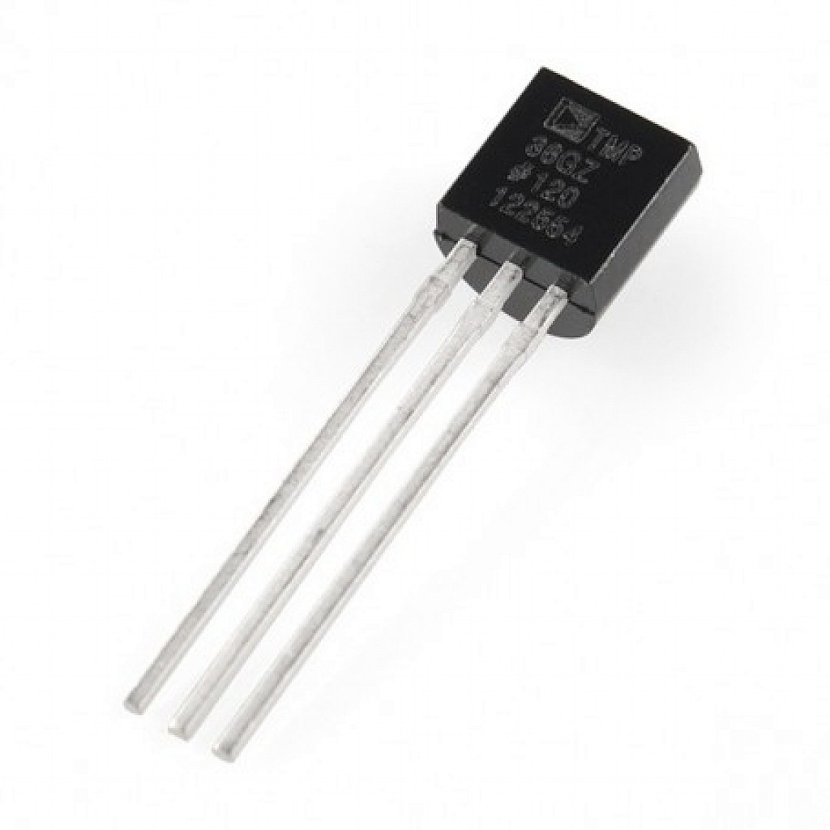
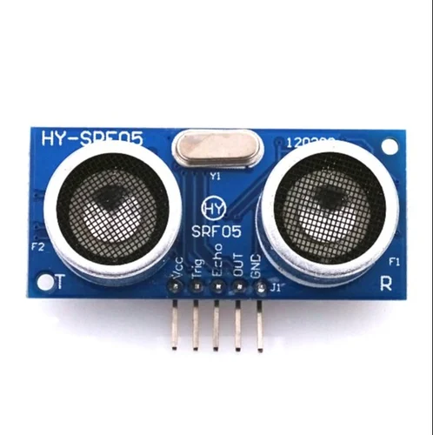
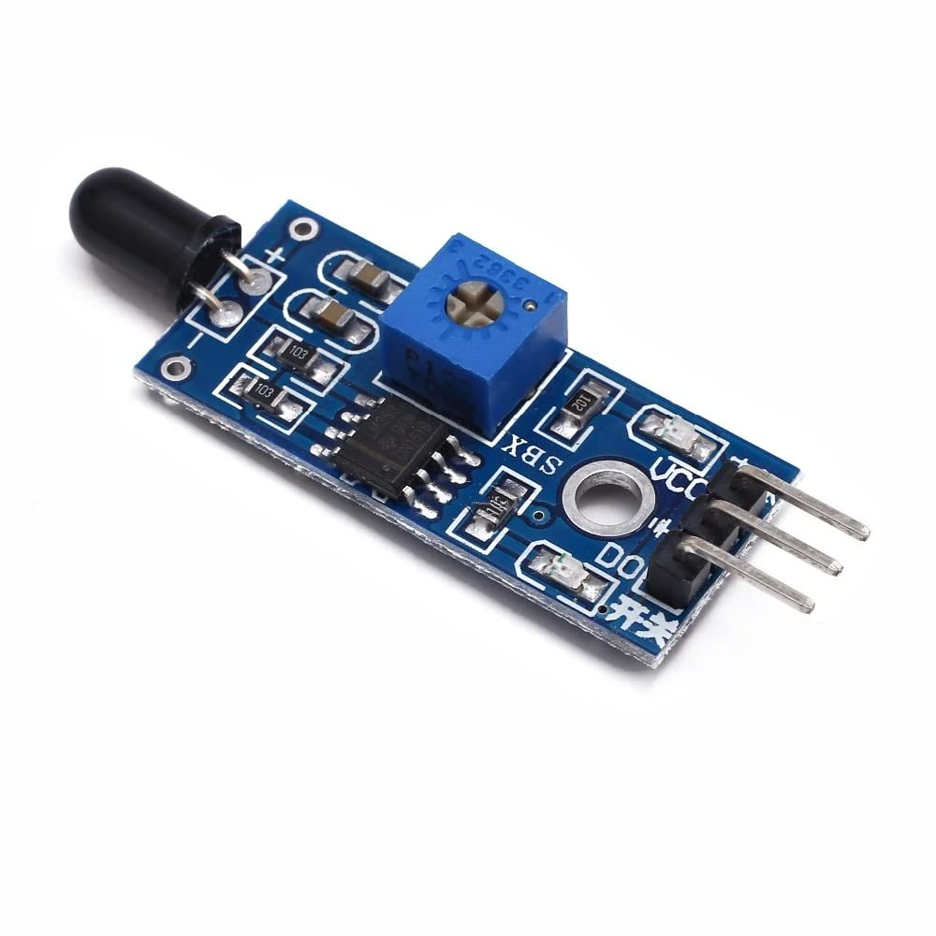

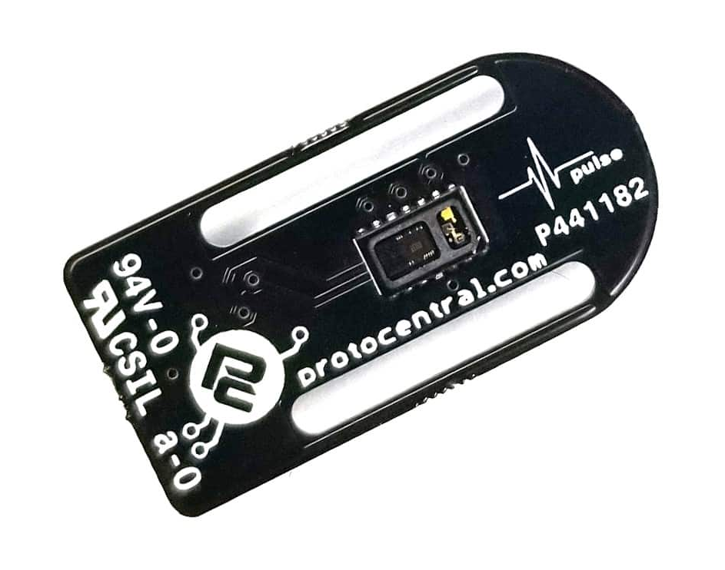
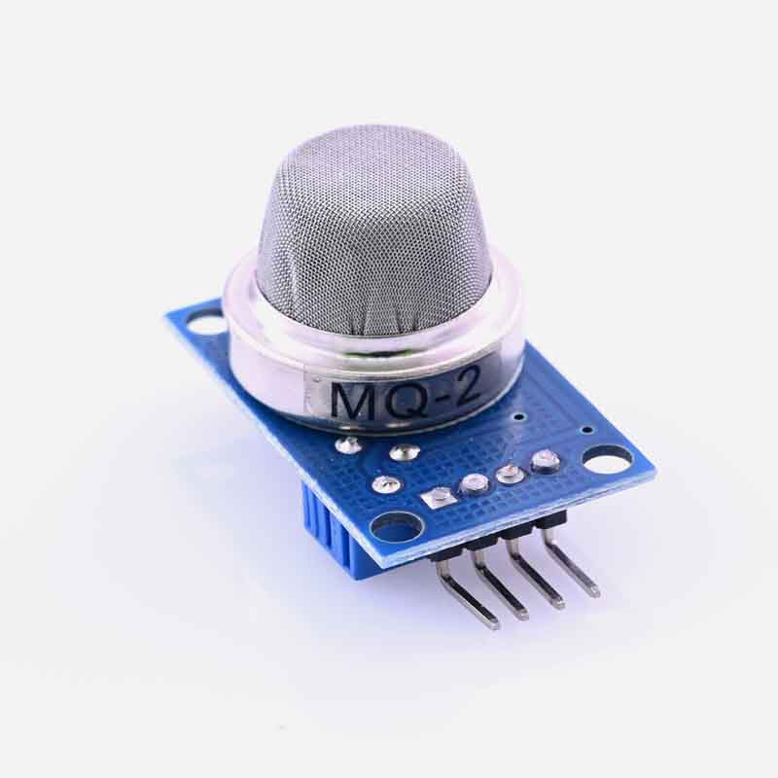
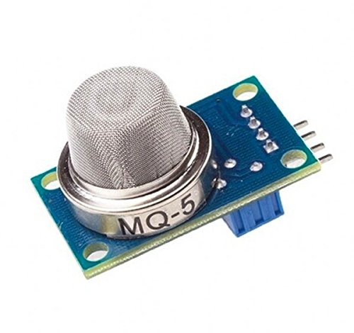
SENSORS USED
Temperature
ULTRASONIC
FLAME
PULSE OXIMETER
SMOKE
GAS

Slide 7
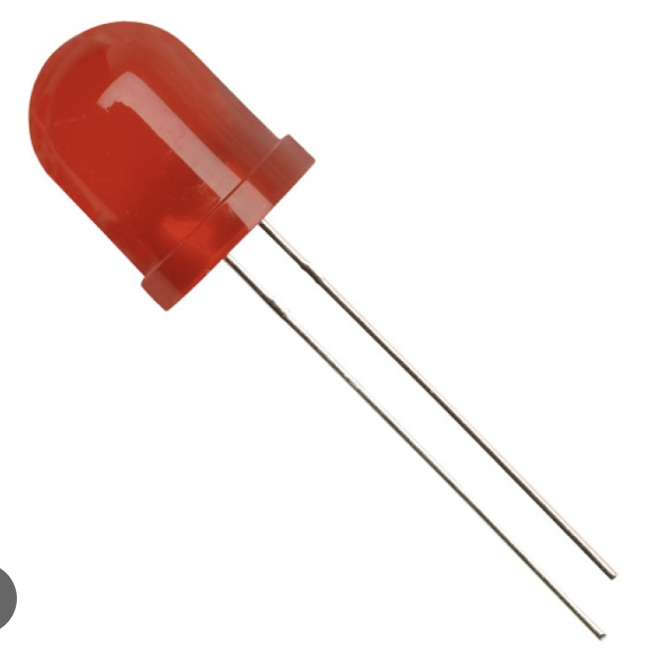
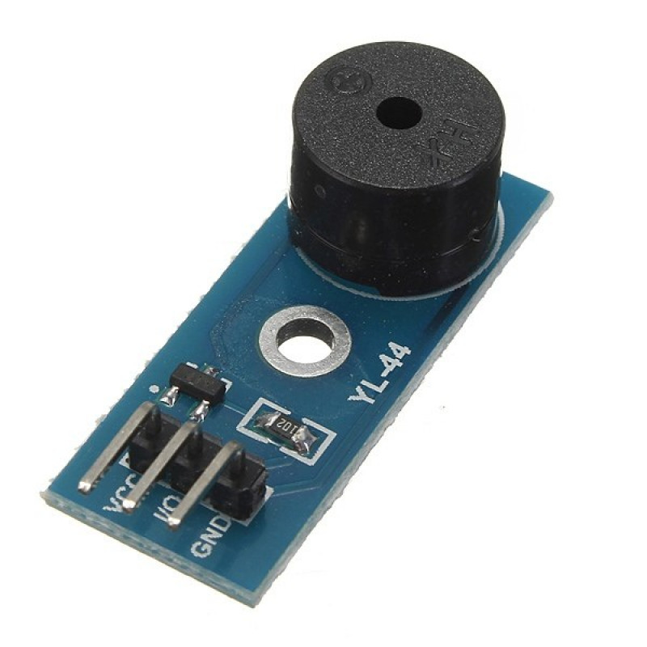
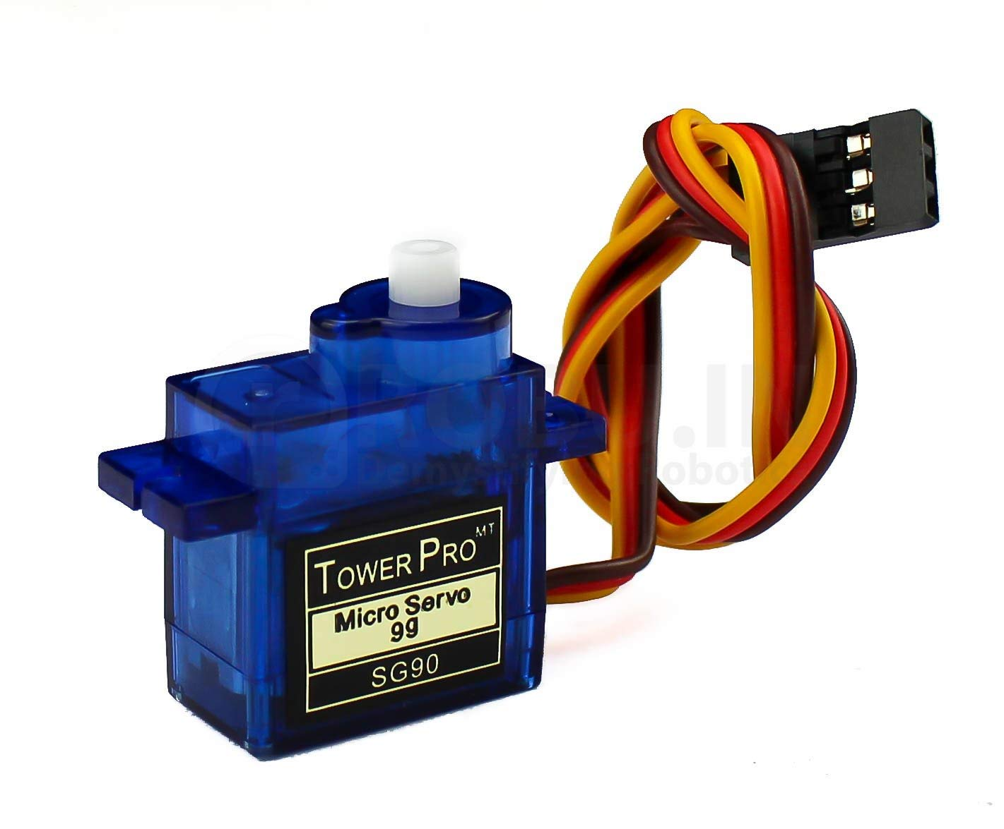
ACTUATORS USED
BUZZERS
ledS
servo

Slide 8
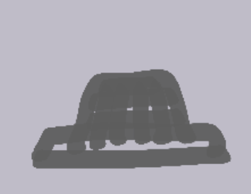
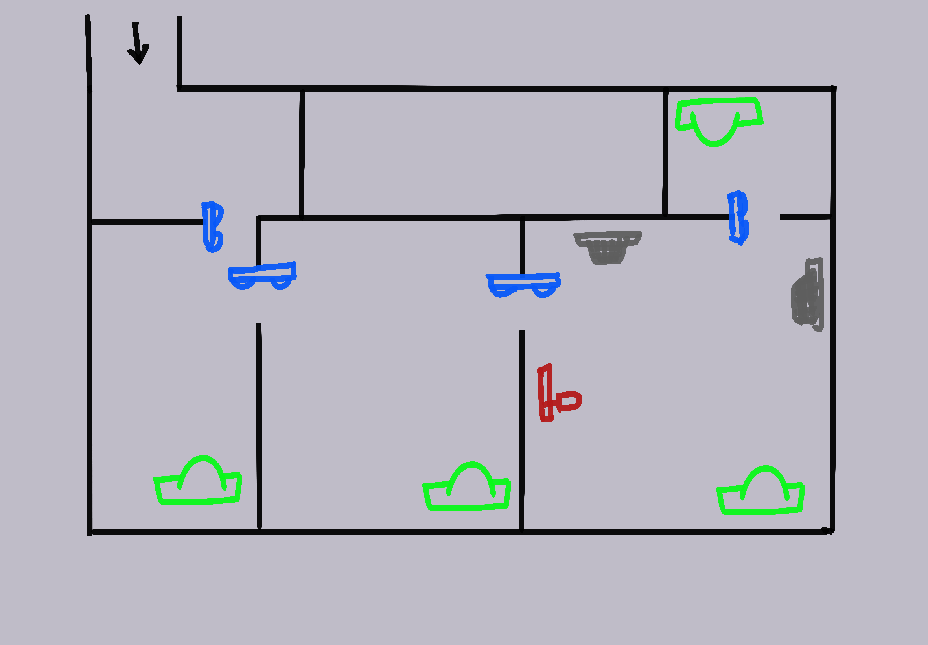



HOME LAYOUT
Smoke, LPG
Flame
ENTRANCE
WIRING ROOM
BATHROOM
Ultrasonic
LIVING ROOM
BEDROOM
KITCHEN
PIR

Slide 9
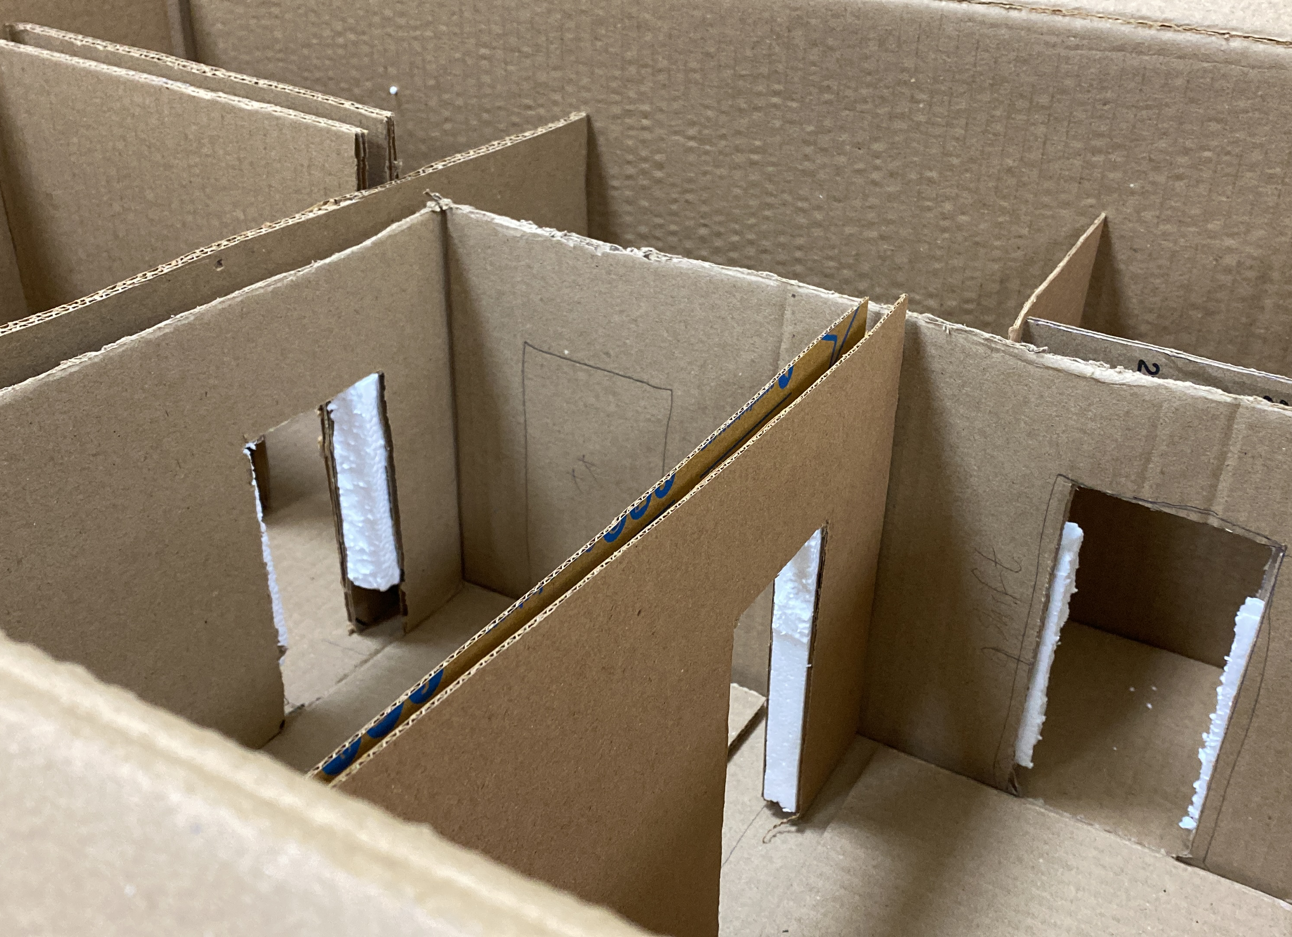
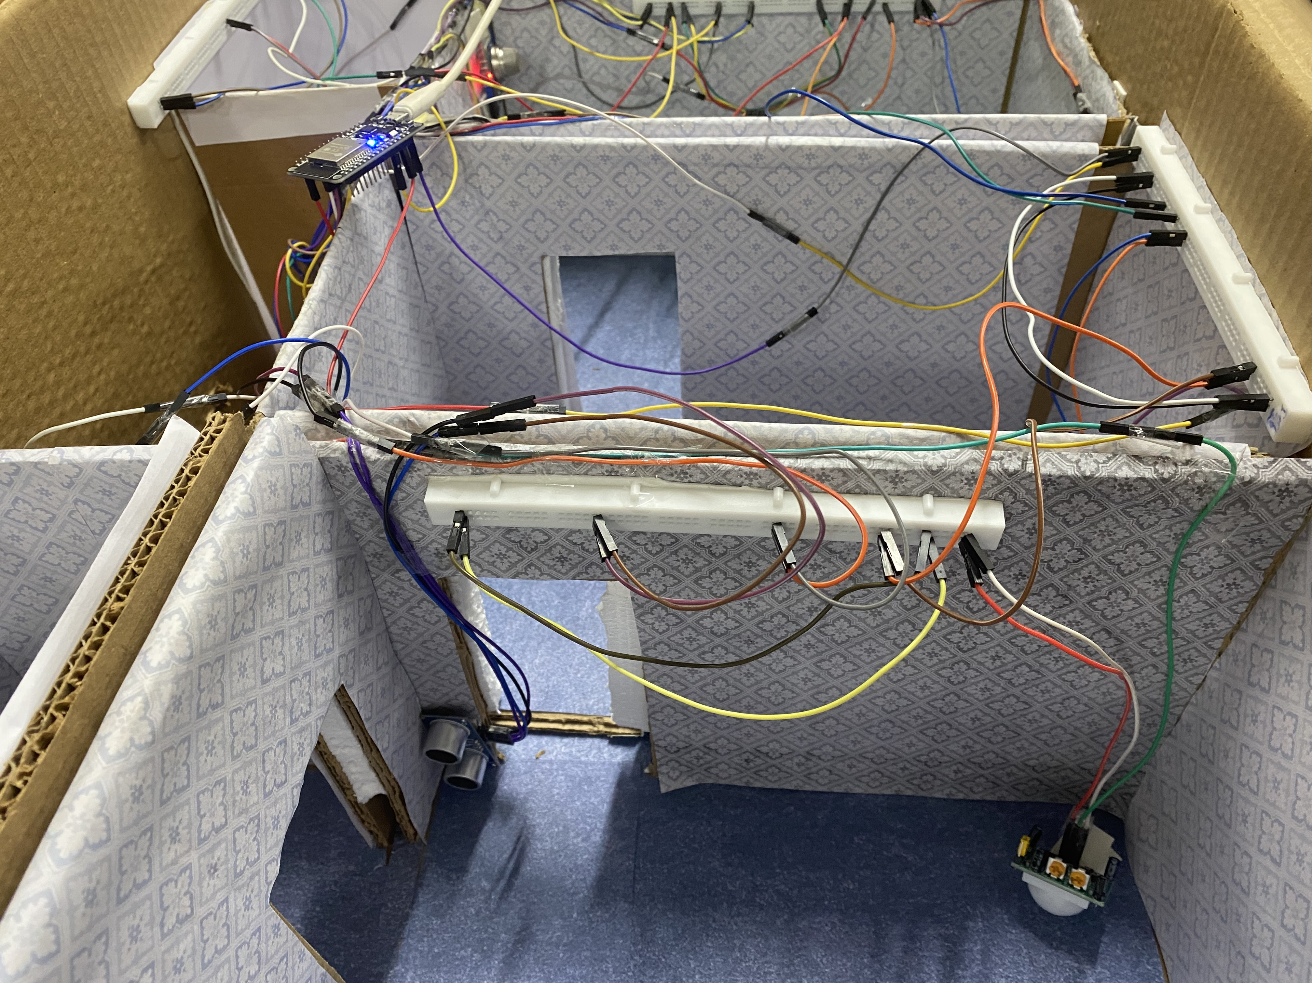
MODEL

Slide 10
Potential improvements
VOICE RECOGNITION
Voice recognition technology that allows users to control features by speaking
FALL DETECTION
Detect when there is an accidental fall using gyroscope
Security
Security systems that detect unwelcome intruders and alert the occupant

Slide 11
Data collection
ambiEnce
User patterns
The Room data collected can be analyzed in order to identify which room the occupant of the house spends the most time in.
Using this data, things like air conditioning or lights can be automatically activated in that particular room in order to provide as comfortable an experience as possible.
Air quality data (currently measured using the smoke detector) can be used in order to automatically activate devices like air purifiers to maintain the highest level of comfort possible.
The data collected can also be used to identify user patterns. For example, room data can be used to identify sleeping trends, and as such lights can be turned off across the house automatically after a certain point in the day.
Collected and analyzed health data can be used to identify any potential problems with the occupant’s health, such as low Oxygen levels or an abnormally high heart rate. This can be used to predict any potential problems before they occur, acting as a forewarning system.

Slide 12
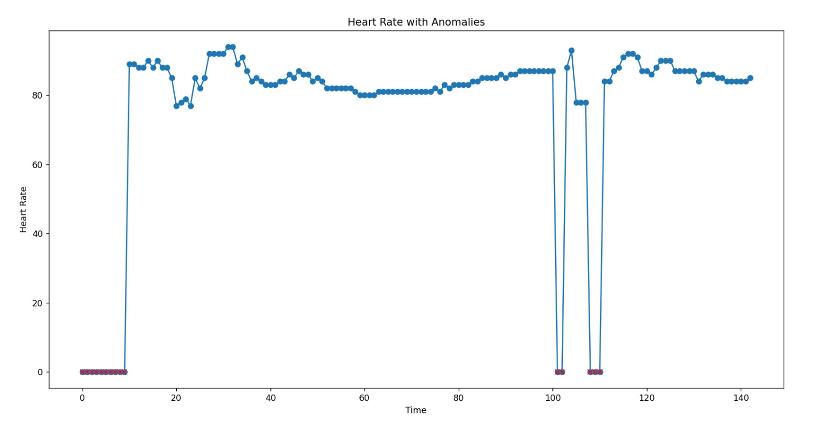
Heart rate data

Slide 13
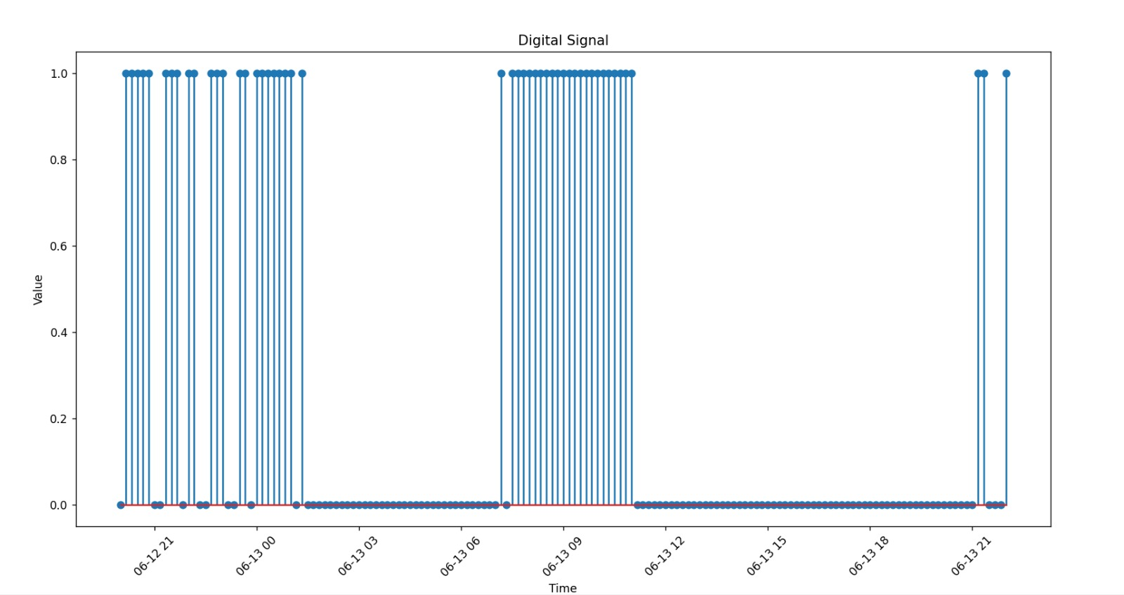
Light usage data

Slide 14
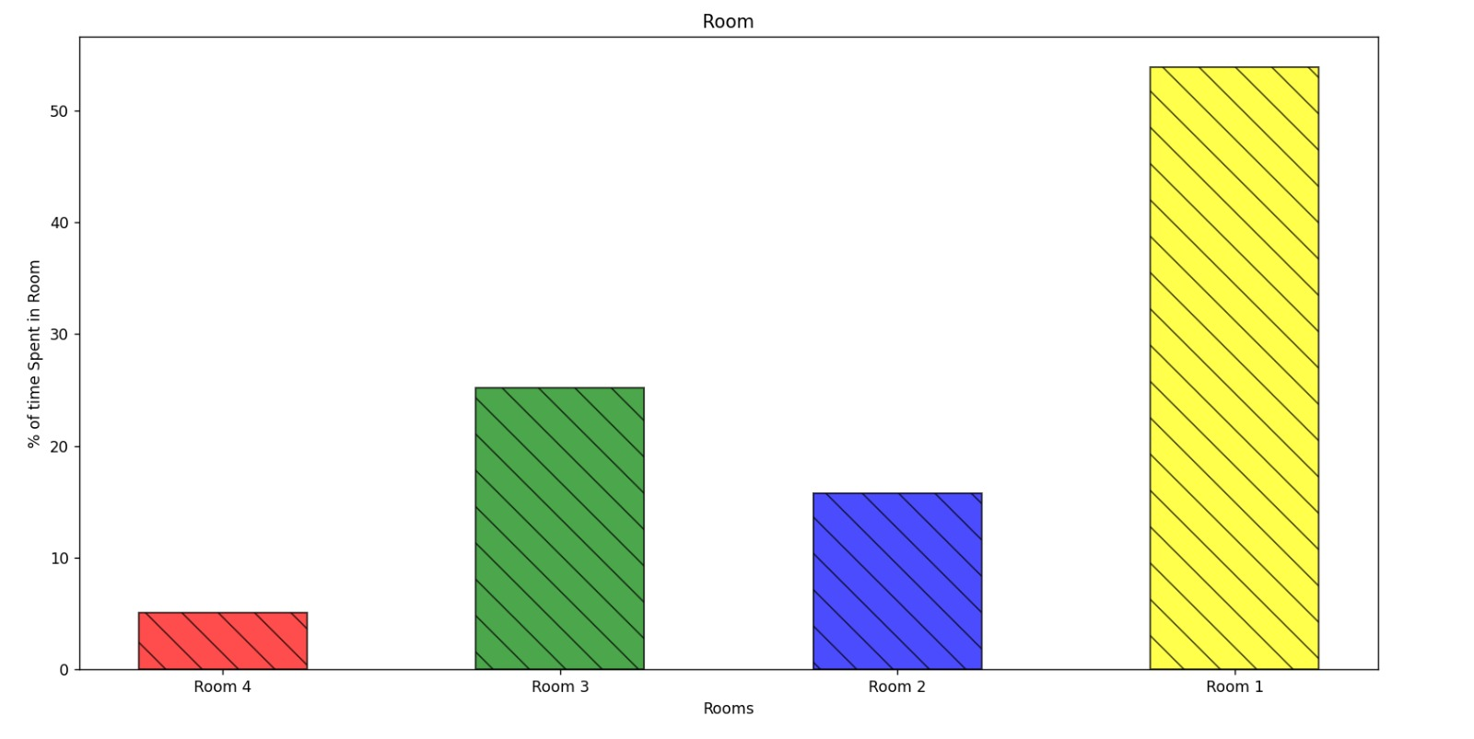
Room occupancy data

Slide 15
Failure analysis
The PIR sensors even with a low sensitivity detected radiation haphazardly as multiple sensors in a small area caused stray IR. Due to the erratic frequency of false highs, we decided to rely on the ultrasonic sensors only for the position sensing.
PIR sensors
After we calibrated the gyroscope, calculated offsets, and developed the model to detect the fall, the sensor stopped communicating with the ESP32. The replacement we received did not work either.
Gyroscope
The voice recognition sensor we desired was too pricey for our budget; the substitute sensors we received involved more complex data extraction and analysis and was out of our scope to implement in this project.
Voice Detection

Slide 16
Failure analysis
Kitchen sensors
The sensors of the kitchen were outputting multiple false highs. The sensors were recalibrated with appropriate sensitivities to correct the readings.
Security
The current implementation of the project allows persons with access to the same Wi-Fi to be able to access all the data being sent. This is due to the flask server indiscriminately
Wiring
The initial circuitry was unstable and led to malfunctions. Longer wiring and stable placements allowed for more reliability.

Slide 17
Team Members
Prakhar Singhal - 2022111025
Aisha Yamina Harris – 2022101012
Aravind Jagannathan Tearle – 2022101016
Palle Sreeja – 2022101081
Yattapu Deekshitha – 2022101009
Divyaraj Mahida – 2022101085
Divyansh Pandey – 2022101111
Kuvam Pahuja – 2022101030
Namrata Baliga – 2022101021
Ashwin Kumar – 2022101091
Chetan Mahipal - 2022101096

Slide 18
Individual contributions
software
Divyaraj Mahida – 2022101085
Data transfer: door, light, temperature
Smoke and temperature sensors
Aravind Tearle – 2022101016
Assigned health sensor and ultrasonic
Tabletop design
Namrata Baliga – 2022101021
Assigned PIRs
Tabletop construction
Palle Sreeja – 2022101081
Assigned flame sensor
Tabletop
Yattapu Deekshitha – 2022101009
Assigned LPG

Slide 19
Individual contributions
User interface
Aisha Yamina Harris – 2022101012
Assigned pressure sensor
Page styling
Tabletop design and construction
Divyansh Pandey – 2022101111
Assigned voice recognition
JavaScript
Chetan Mahipal - 2022101096
Assigned gyroscope
JavaScript
Health sensor

Slide 20
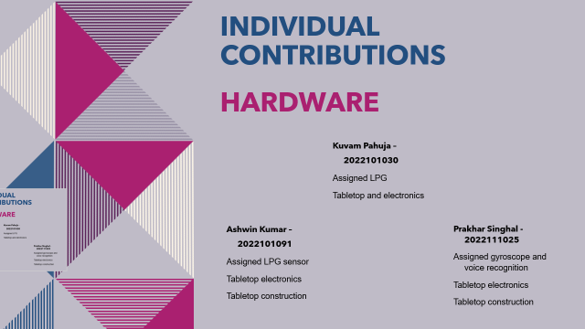
Individual contributions
hardware
Kuvam Pahuja – 2022101030
Assigned LPG
Tabletop and electronics
Ashwin Kumar – 2022101091
Assigned LPG sensor
Tabletop electronics
Tabletop construction
Prakhar Singhal - 2022111025
Assigned gyroscope and voice recognition
Tabletop electronics
Tabletop construction

Slide 21
THANK YOU

